Slide 1
NLP on tweets: Analyzing twitter data about sexual abuse and assault
Prabha Nayak
December 3, 2019

Slide 2
1. Accessing Twitter public API to obtain data
Create a twitter account if you do not already have one.
Go to https://apps.twitter.com/ and log in with your twitter credentials.
Click "Create New App"
Fill out the form, agree to the terms, and click "Create your Twitter application"
In the next page, click on "API keys" tab, and copy your "API key" and "API secret".
Scroll down and click "Create my access token“ and copy your "Access token" and "Access token secret".
Number of tweets gathered = 19862
Number of features = 68

Slide 3
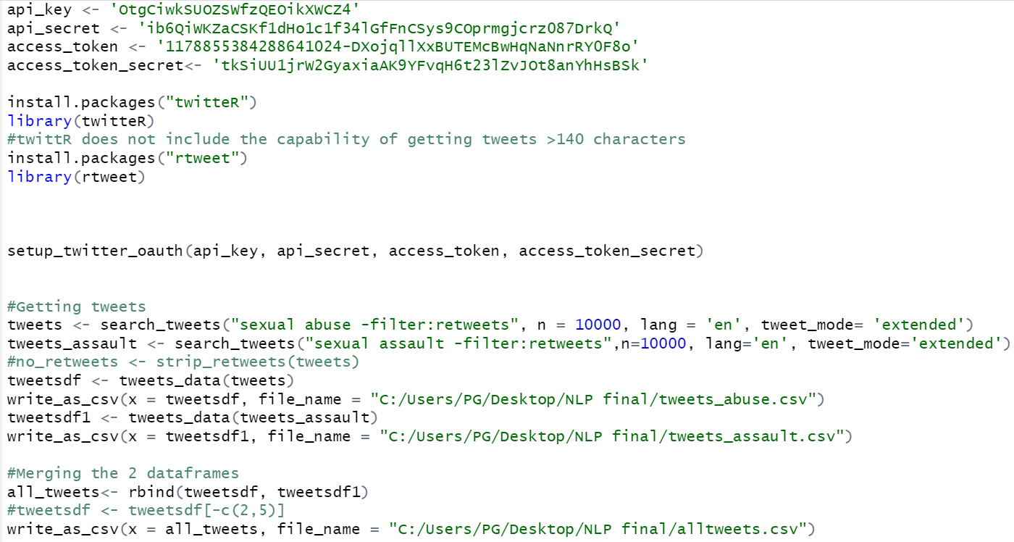

Slide 4
NLP Pipeline

Slide 5
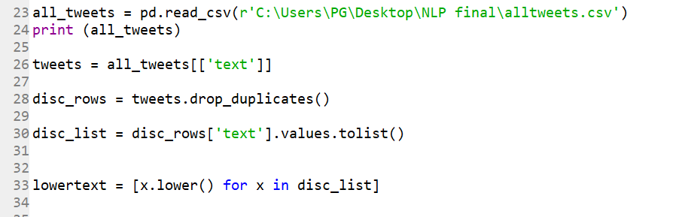
2. Preprocessing of data
Convert to lowercase
Column ‘text’ extracted from the all_tweets dataframe
Text converted to lowercase using lower()

Slide 6

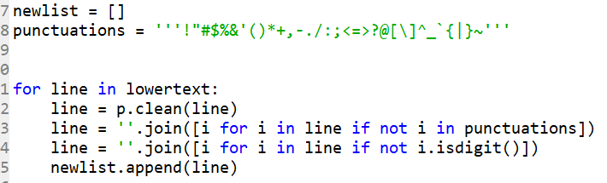
2. Preprocessing of data
b. Remove URL, Punctuations and numbers

Slide 7
2. Preprocessing of data
c. Remove duplicates
Each tweets ends with a distinct URL.
So removing duplicates preferred after removing the URLs from tweets.

Slide 8
2. Preprocessing of data
d. Tokenization
Tokenization using the split() method

Slide 9
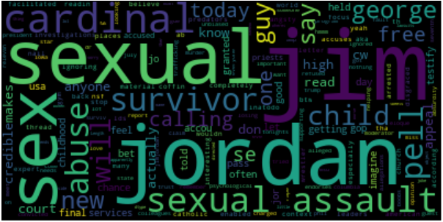
Word Cloud generation before

Slide 10


2. Preprocessing of data
e. Removing Stop Words

Slide 11
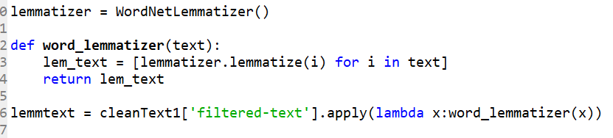
2. Preprocessing of data
f. Lemmatization

Slide 12


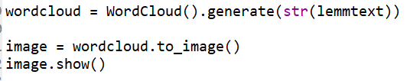
3. Analysis
Word Cloud generation

Slide 13
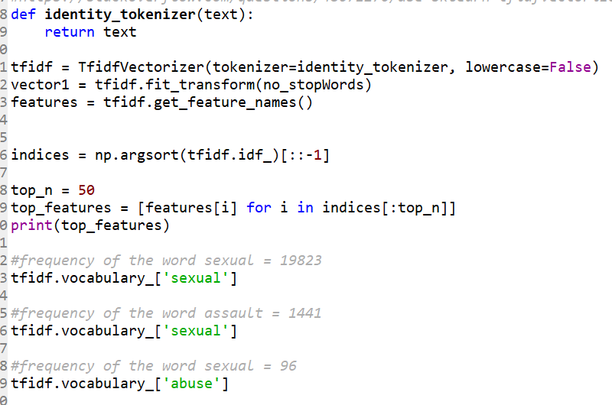
3. Analysis
a. TF-IDF

Slide 14
Next Steps
Try n-grams
Train-test split
Fit training data to a model
Fit the test data to the model to obtain results

Slide 15
References
https://stackoverflow.com/questions/34860982/replace-the-punctuation-with-whitespace
https://codereview.stackexchange.com/questions/115954/writing-lists-to-csv-file
https://gis.stackexchange.com/questions/72458/exporting-list-of-values-into-csv-or-txt-file-using-arcpy
https://stackoverflow.com/questions/13464152/typeerror-unhashable-type-list-when-using-built-in-set-function/13464194
https://towardsdatascience.com/nlp-for-beginners-cleaning-preprocessing-text-data-ae8e306bef0f
https://stackoverflow.com/questions/48671270/use-sklearn-tfidfvectorizer-with-already-tokenized-inputs
https://medium.com/fintechexplained/nlp-text-processing-in-data-science-projects-f083009d78fc
https://www.geeksforgeeks.org/generating-word-cloud-python/

Slide 16
Thank you!

